Slide 1

Capstone Project
Exploratory Data Analysis
Individual Project By
Vivek Tripathi
email- Vivektrip93@gmail.com

Slide 2
Content
Problem Statement
Objective
Data Summary
Analysis Based on:
Neighbourhood Group
Price
Room Types
Number of Reviews
Longitude and Lattitude
Conclusion

Slide 3
Problem Statement-
AirBnb Bookings Analysis:
EDA-Exploratory Data Analysis (EDA) is an approach to analyze data
using visual techniques. It is used to discover trends, patterns, or to check
assumptions with the help of statistical summary and graphical
representations.
Since 2008, guests and hosts have used Airbnb to expand on traveling
possibilities and present a more unique, personalized way of experiencing
the world. Today, Airbnb became one of a kind service that is used and
recognized by the whole world

Slide 4
Data analysis on millions of listings provided through AirBnb is a crucial
for company.
These millions of listings generate a lot of data - data that can be analyzed
and used for security, business decisions, understanding of customers' and
providers' (hosts) behavior and performance on the platform, guiding marketing
initiatives, implementation of innovative additional services and much more.

Slide 5
OBJECTIVE
Finding the total number of listings available in New York.
Find the average price .
Find the owner/hosts who has the most number of listings
throughout New York.
Find out the reason how price is affecting the maximum reviewed
place.
To see the price variation for different listings throughout
New York.

Slide 6
Data Summary
The AirBnb data set contains 48895 records with 16 Variables.
Total Columns that Dataset Contains:
id
Name
host_id
Host_name
neighbourhood_group
Neighbourhood
latitude
longitude
room_type
price
minimum_nights
number_of_reviews
reviews_per_month
Last_review
calculated_host_listings_count
availability_365

Slide 7
Important Columns:
‘name’- These are names of the properties given by specific hosts.
‘host_id’- Many properties re being offered by many hosts. This is the
specific id given to host.
‘neighbourhood_group’ and ‘neighbourhood’- These columns holds the
information about the city and areas of the properties which
are offered in here.
'Longitude' and 'Latitude’- As the name suggests it just contains the
longitude and latitude of the property location.
'Room_type’ = It displays the room_type of the property
( either private room / entire home / shared room )

Slide 8
'price’- Its an important column which holds the price value of all those
properties
'number_of_reviews' and 'reviews_per_month’ - It clearly tells about the
number of reviews and reviews per month for those properties and
hosts hospitality.

Slide 9
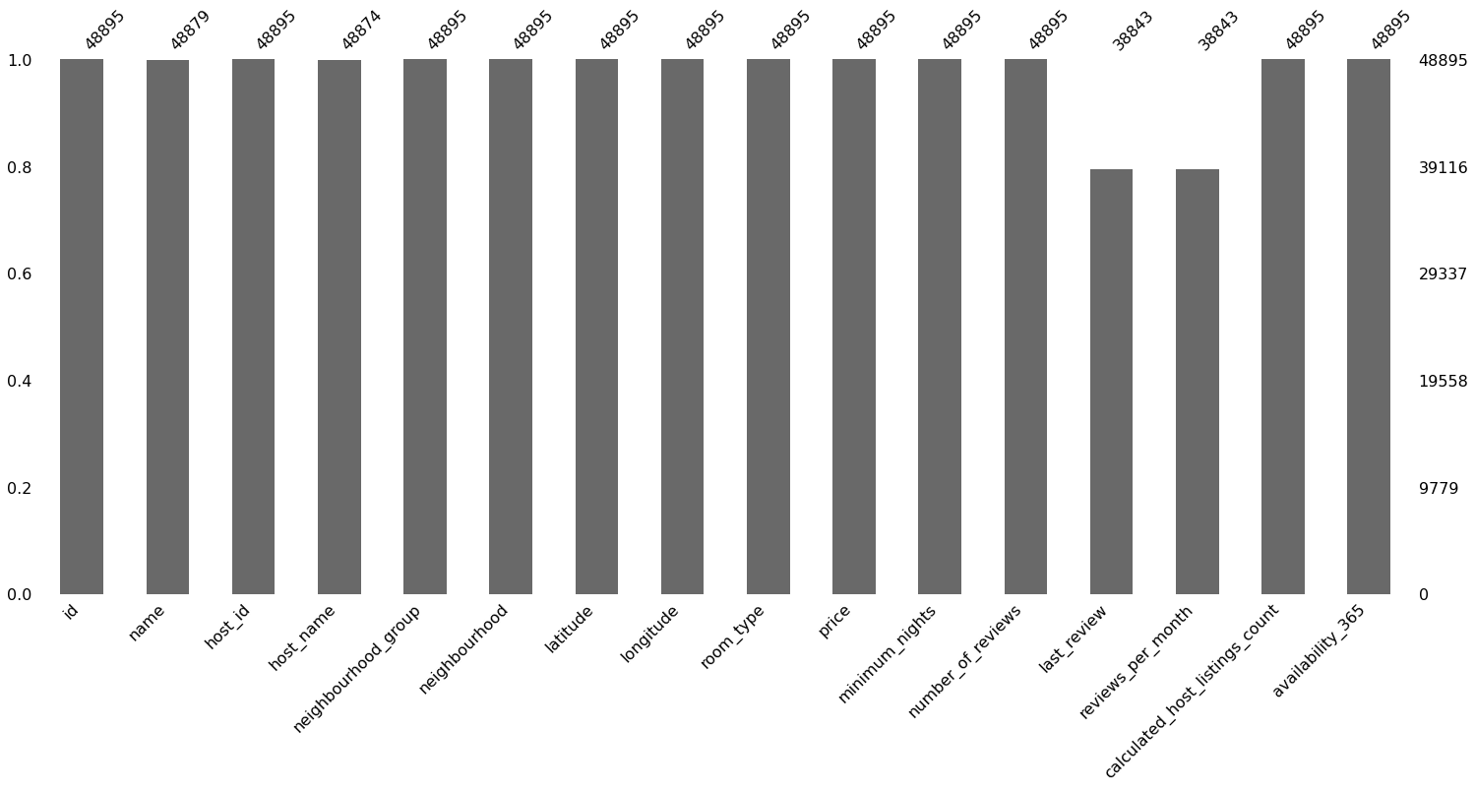
NA Values

Slide 10
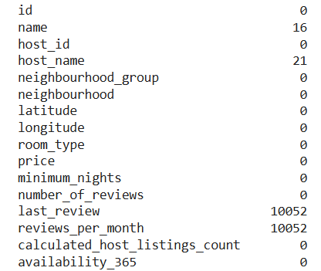
There are 16 NA values in ‘name’ column, 21 NA values in ‘host_name’ column, 10052 NA values in ‘last_review’ & ‘reviews_per_month’ columns.

Slide 11
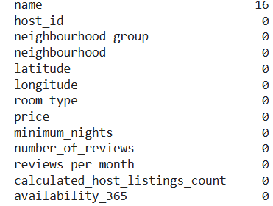
Treating NA
If we have a look at the number of null values throughout the data set,
then we can observe that we found some of NA values in few columns.
Last_review column contains 10052 records with null values.
This column is not much of a help to analysis. So we drop that column.
We then replaced the null values of
‘reviews_per_month’ column as 0.

Slide 12
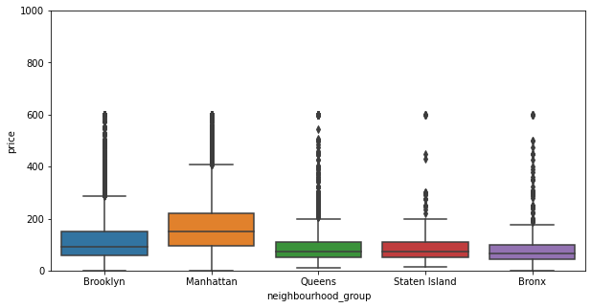
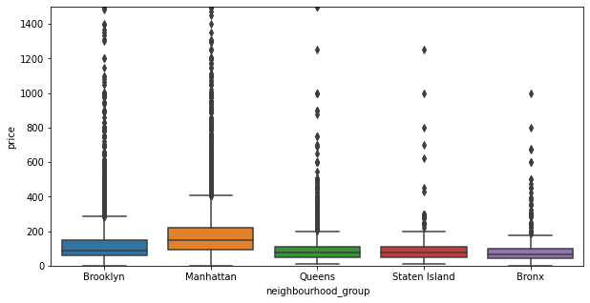
Outliers
We observed there are only 1044 records which are having more than 500 as the price. So just taking the price of property which are more than 600 as 600, which will just minimize the number of outliers.

Slide 13
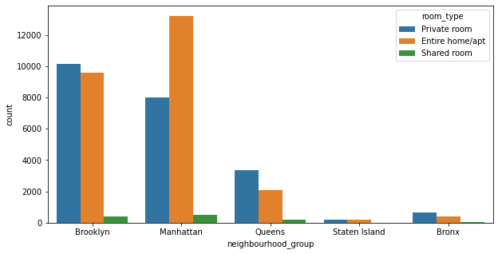
Neighbourhood Groups
Number of properties available in different neighborhood groups is more in
Manhattan(Home room type)

Slide 14
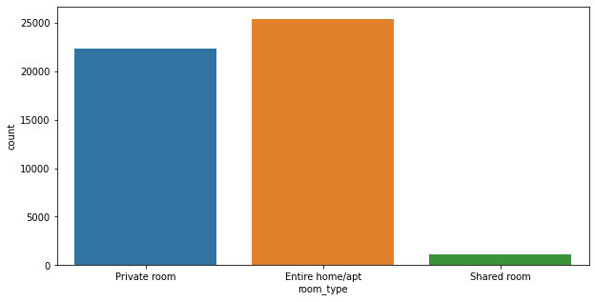
Room type throughout New York
Number of room types available in New York which are of the type Private room, Entire home/Apartments, Shared room.

Slide 15
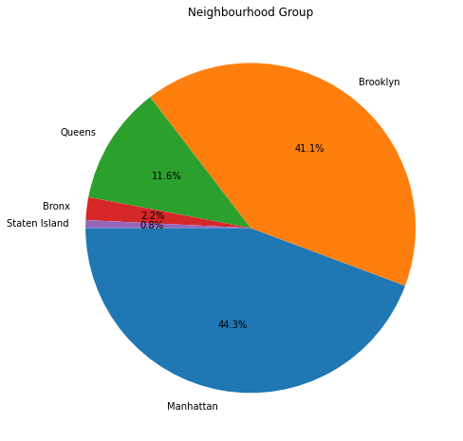
% of listings offered by each neighborhood groups in New York

Slide 16
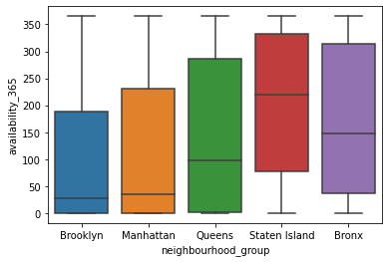
Availability of the listings and neighborhood group
We can observe that the mean of listings count in Brooklyn, Manhattan and Queens are available only for 0 to 100 days a year.

Slide 17
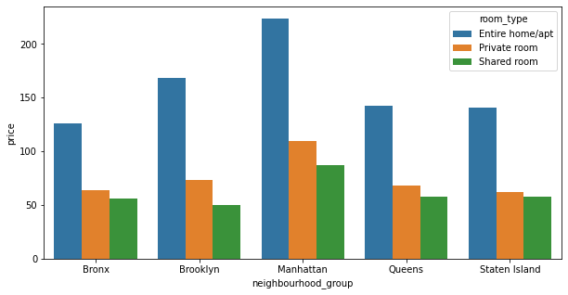
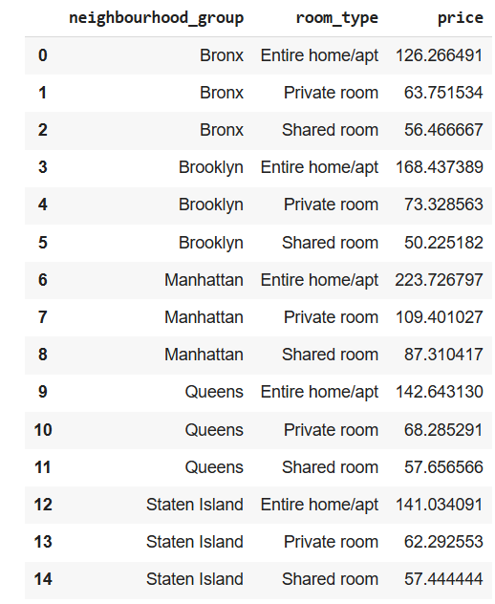
Average price for each room type in neighborhood
If we compare the average price per stay in different neighborhood groups,
we can observe that its high in Manhattan for Entire home/ Apartment.

Slide 18
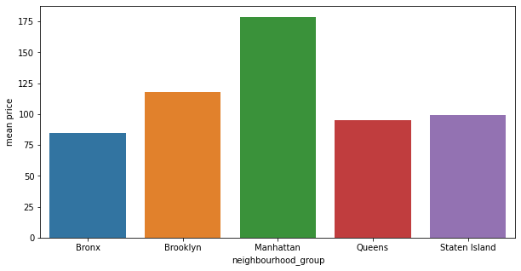
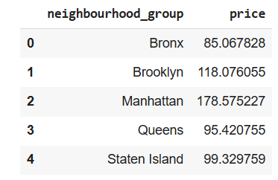
Average price for each neighborhood in NY
Now we are comparing the overall average price per stay throughout New York for different neighborhood groups. Its clear that its high in Manhattan

Slide 19
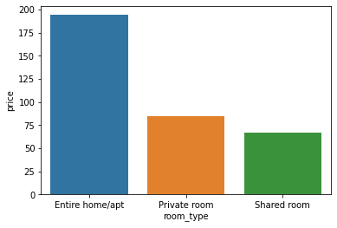
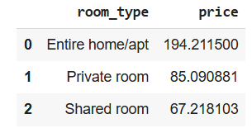
Average price for each room type
By comparing average price through out New York in different available room types, we can observe that, Home/ Apartment is the category which has maximum average price.

Slide 20
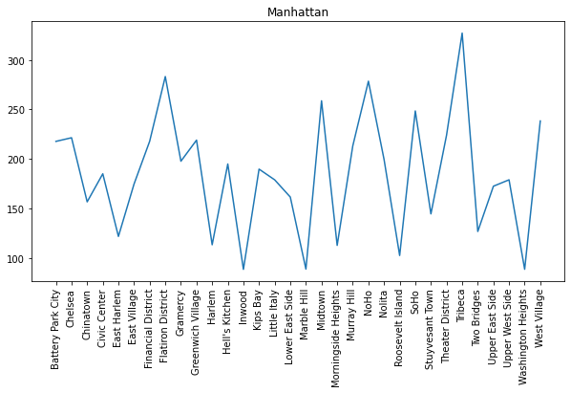
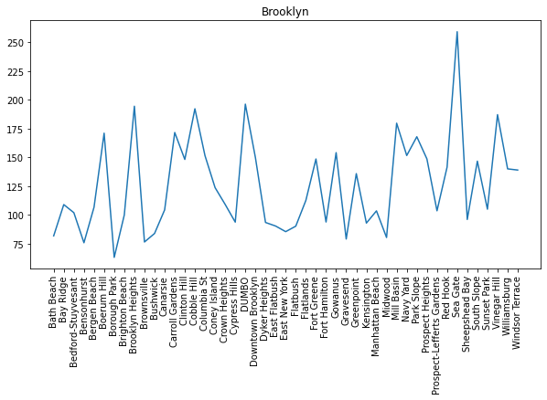
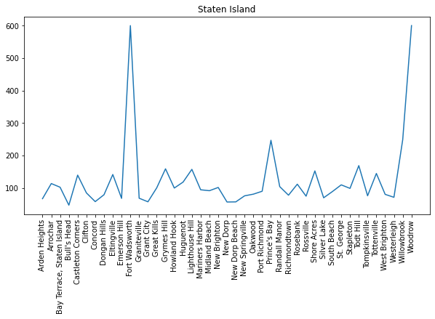
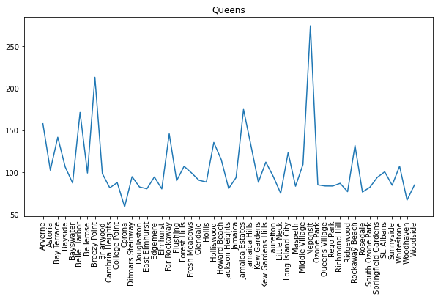
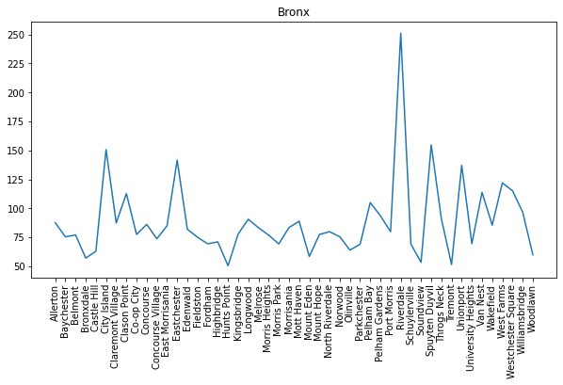
Price variation for each neighborhood group
We can see the price fluctuations through out different neighborhood groups. It differs from place to place, heavily in Manhattan.

Slide 21
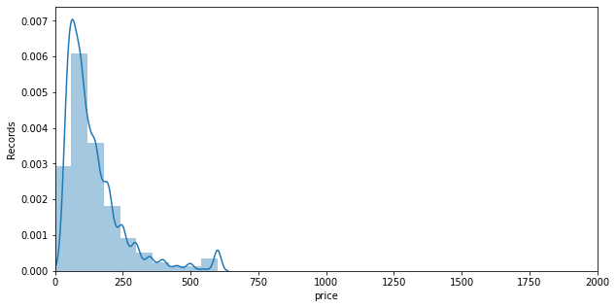
Frequency distribution of price throughout New york
We can observe that the price range between 0 to 250 is the price which most listings in New York offers for their places.

Slide 22
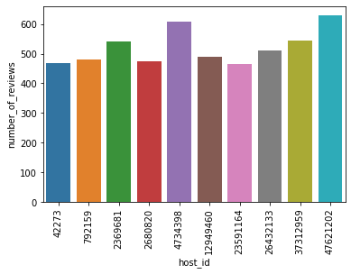
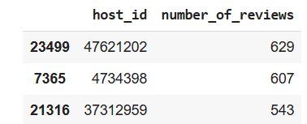
Hosts who got more number of reviews
Host with the host_id 47621202 has the highest number of reviews throughout New York.

Slide 23
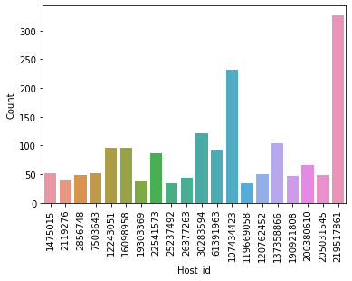
Famous Host/ host with more properties
We can see the list of hosts id who possess more number of properties in New York. The maximum listings are offered by host id 219517861

Slide 24
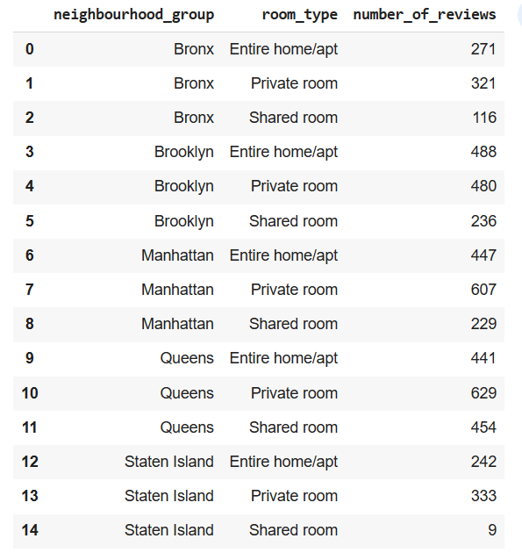
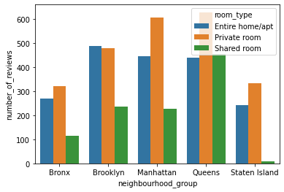
Places where number of reviews were max
We trying to plot a maximum reviews obtained for listings in particular neighborhood groups with selected room types. Queens clearly has the maximum reviews.

Slide 25
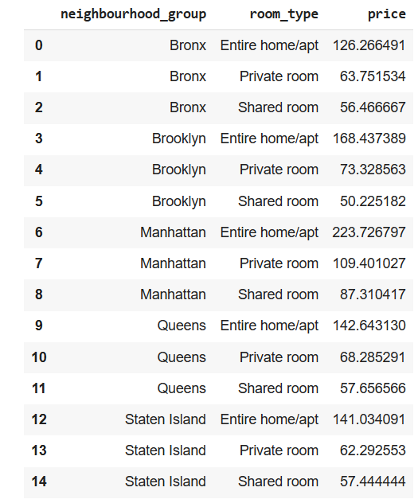
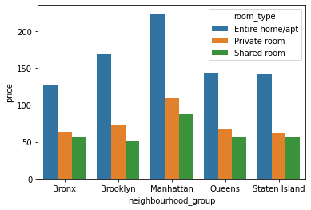
Average price per night
Manhattan has the highest price for a single night in all room types.

Slide 26
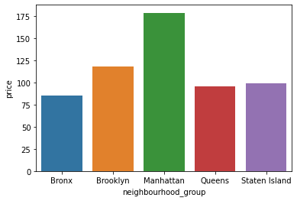
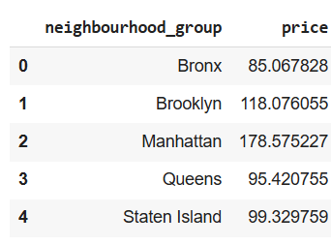
Average price per night in neighborhood groups
We can observe that even if Consider overall Manhattan listings, The average price for a night is High in Manhattan

Slide 27
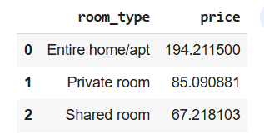
Average price for night in all room types in New York
Entire home/Apartments is type Which has the highest average Price for night in all over New York

Slide 28
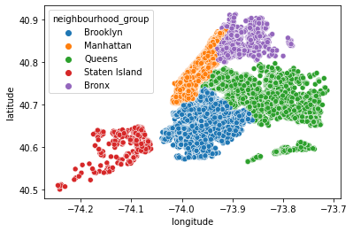
Longitude and latitude
We can see the geo locations of all neighborhood groups throughout New York

Slide 29
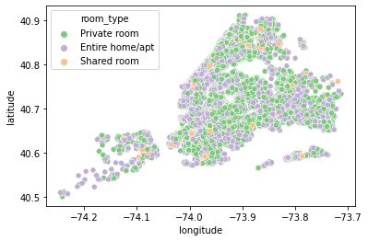
Room types available in respective location
We can see the different room types available throughout New York

Slide 30
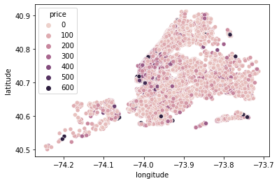
Price variations for different location
We can clearly see the places which is offering listings with maximum price throughout New York

Slide 31
Conclusion
Price depends on Neighbourhood group. Its high in Manhattan. Manhattan is the city which has a lot of price fluctuations. We can even find the less prices for some listings in particular neighbourhood. We can even find the costliest listings in the same neighbourhood.
We can get the famous host from Manhattan and the number of properties he is offering. He owns many properties throughout Manhattan, New York, which in turn is the busiest city in New York.

Slide 32
We can observe one host from Queens has the property with more number of reviews. Queens is the place where there are listings available with reasonable price when compared to New York. We can conclude that people tend to go to the place with reasonable price.
Throughout NY, Entire home/apt is the room type which is mostly in demand.
Manhattan is the place which is famous and can be a good option for the companies to invest on properties of Entire home/Apt.
We can increase the number of room type of places whichever got more number of reviews.

Slide 33
Thank You

